Slide 1
EMPLOYEE MANAGEMET SYSTEM
Arvind Raj
Arvind
Shweta Joshi
Vinay Raj

Slide 2
Problem statement :
1.Inserting Employee records , department records and project records.
2.Searching all the Employees based on department name.
3.Seaching all the projects by the employee-id and printing the details of Employee.
4.Printing projects on department name.

Slide 3
Employee Management records
Employee management
Employee records
Department records
Project records
employee id
Employee name
Email
Phone number
Department id
Department id
Department name
NOofprojects
Project id
Project name
Employee id
Department id

Slide 4
flow of code:
Step 1: Take details of employee ,department and project from user.
Stem 2: Write details of the records in Files by using stream writer.
Insert file reader and write functions.
Each records are saved in 3 different files.
Stem3: Displaying all Employees working in particular department.
=>ask the user to enter department name.
1Read department name
2. get department Id based on department name from Department File
3. get employee from Employee File based on department Id.
Step4: Displaying Employees details by Employee id.
1. Read employee Id
2. get employee based on employee Id
3. get project based on employee Id
Step 5: Displaying projects based on department name.
1. Read department Name
2. get department id based on department Name
3. get project based on department Id

Slide 5
https://github.com/AravindPallerla/aravindpallerl-steamproject.git
Github link of Employee management system.

Slide 6
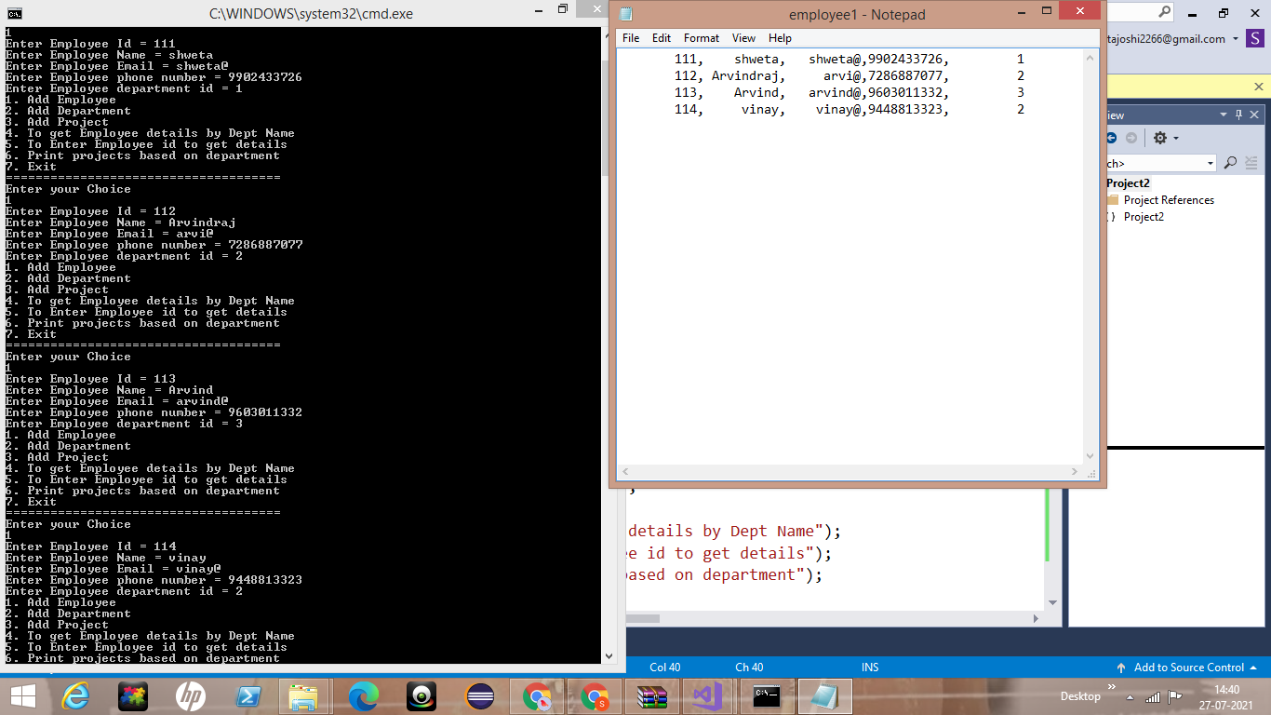
Results snapshots.
Case 1: adding the employee details and writing into the employee file.

Slide 7
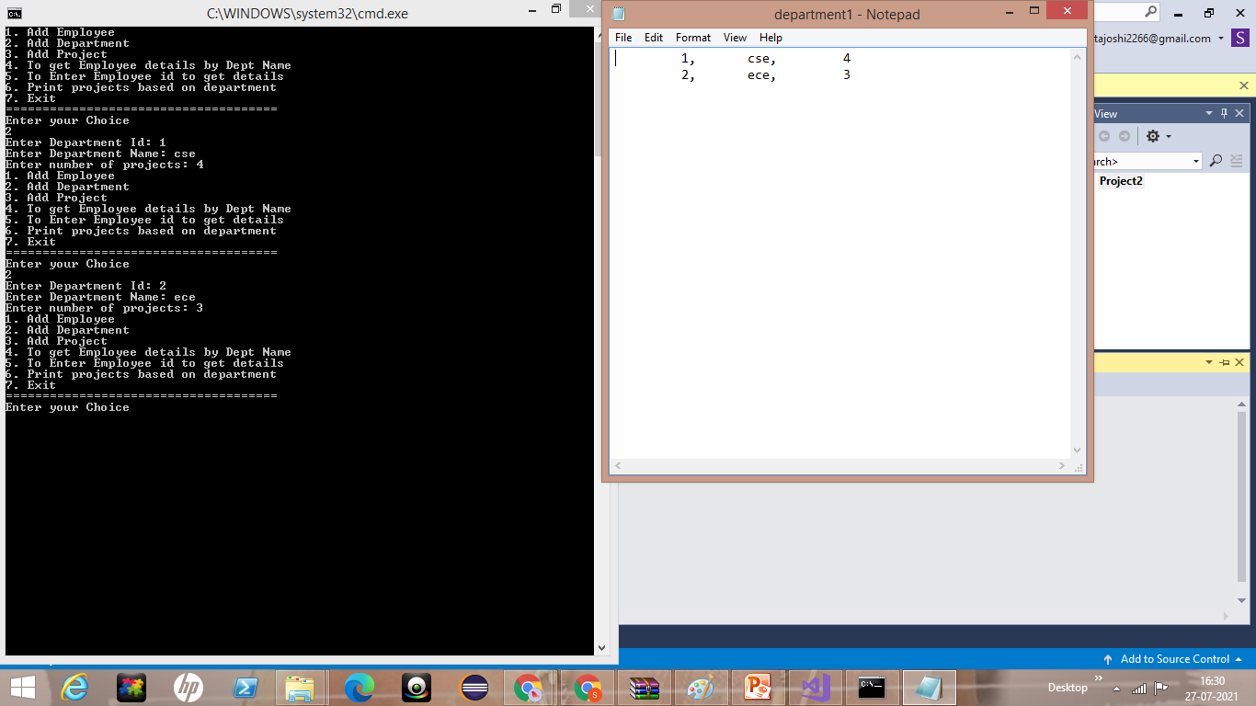
snapshot2:
Case 2: adding the department details and writing into the department file.

Slide 8
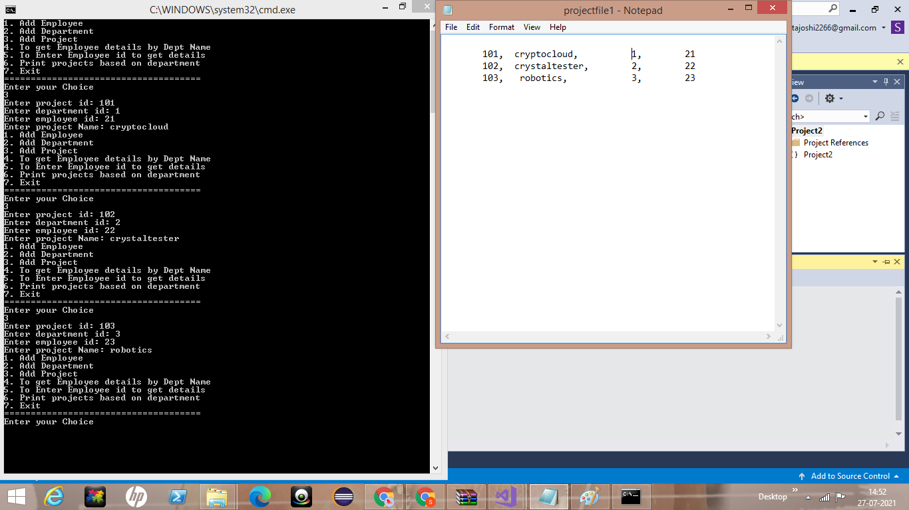
snapshot 3:
Case 3: adding the project details and storing into the project file.

Slide 9
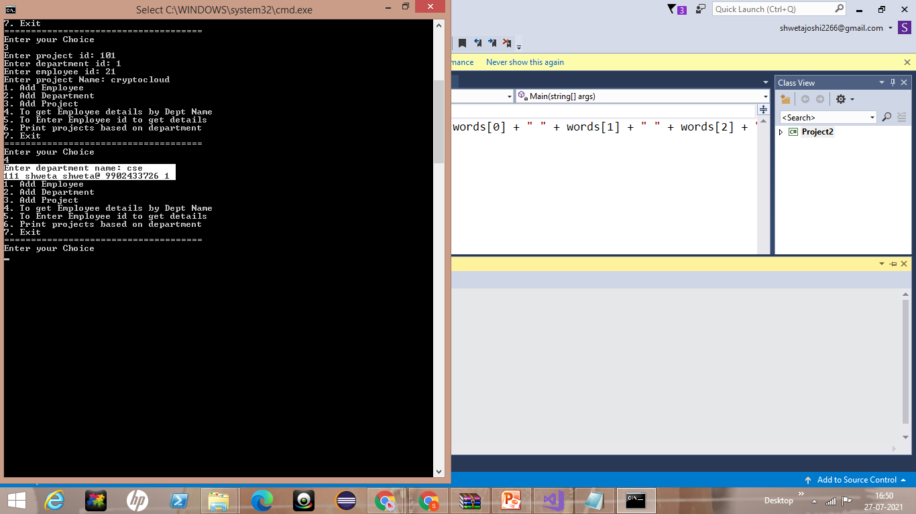
snapshot4:
Case 4: displaying employee details of the particular department .

Slide 10
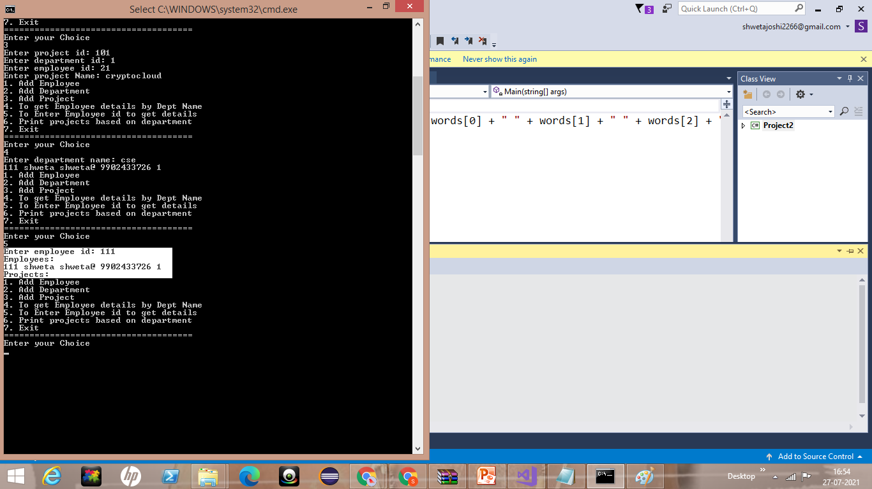
snapshot5:
Case 5: searching employee details based on employee id.

Slide 11
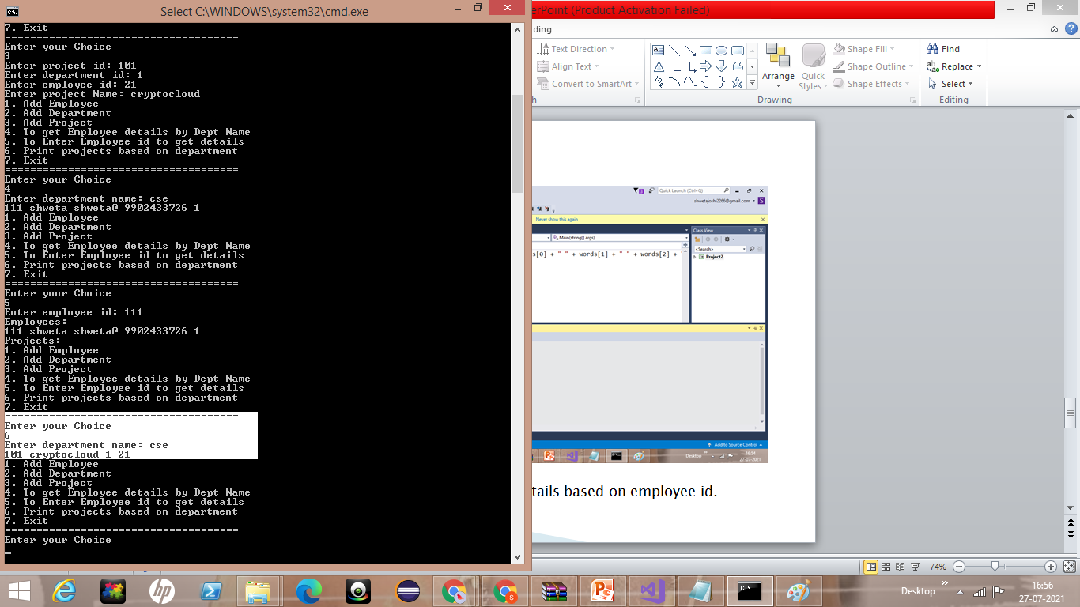
snapshot6:
Case 6: displaying all projects under particular department.

Slide 12
THANK YOU

